Slide 1
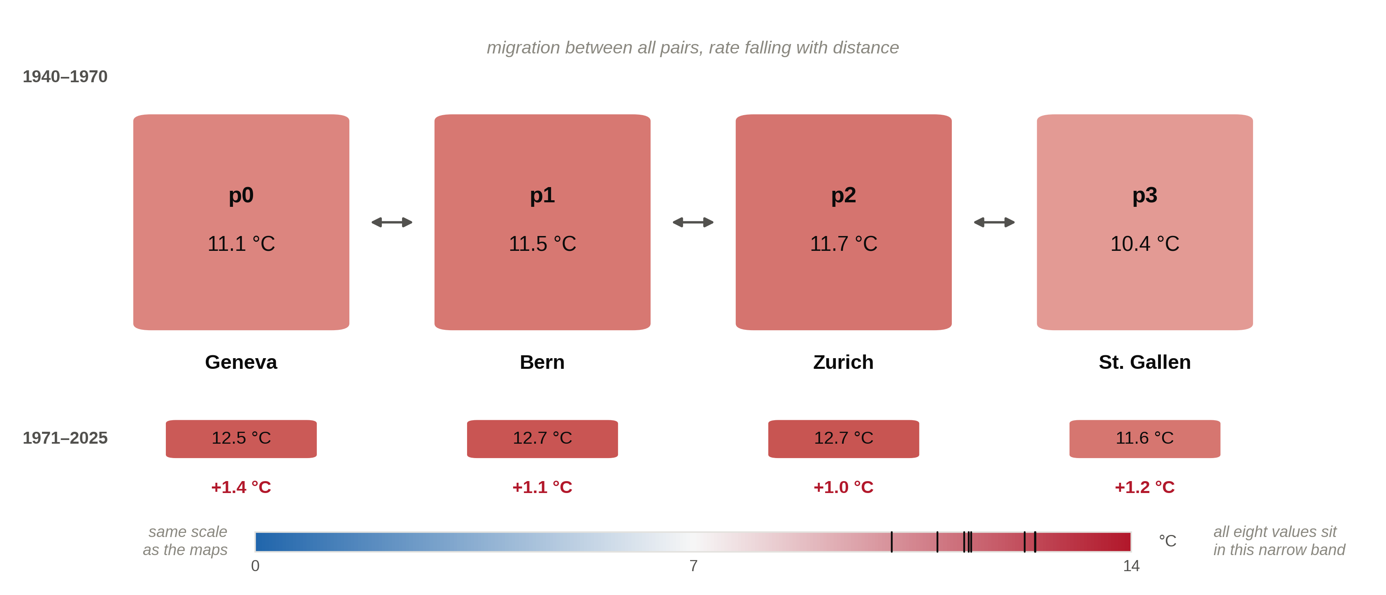
Four populations, four real climates

Slide 2
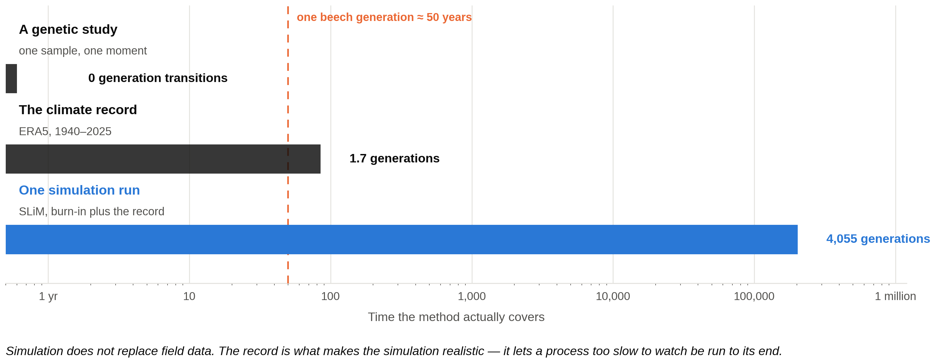
Simulation contextualises what is too slow to observe

